Slide 1

CSE 017 – Programming and Data Structures
Lecture 3 – The Java Programming Language

Slide 2


Slide 3
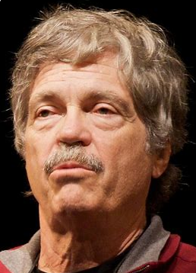



Slide 4

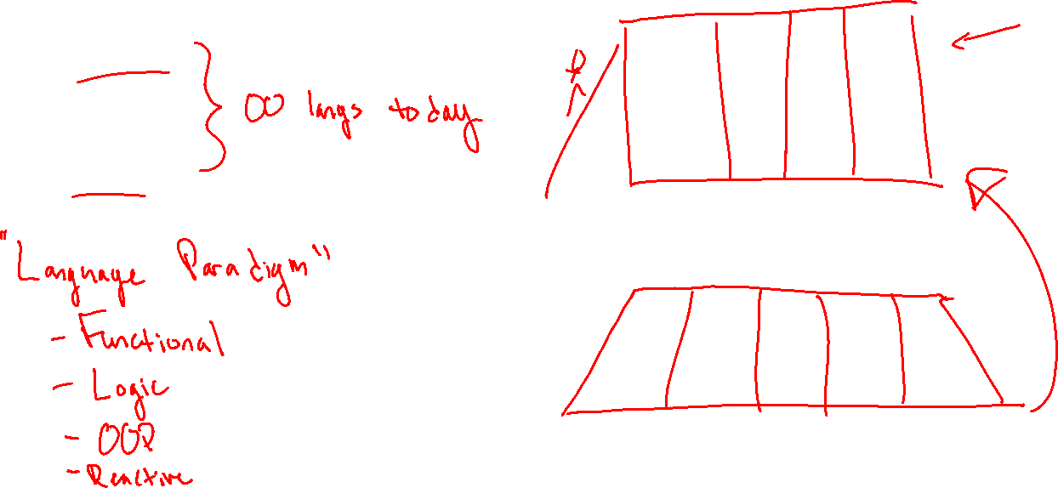

Slide 5

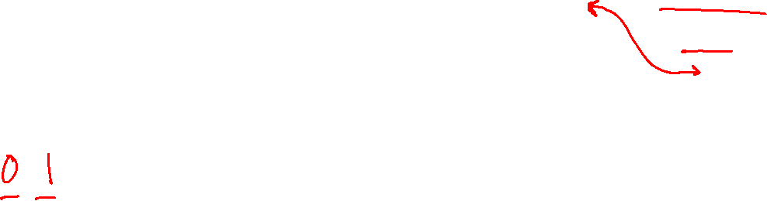

Slide 6


Slide 7

